Slide 1

Bayesian Treaty Monitoring
Dave Moore
Stuart Russell (PI)
University of California, Berkeley
with Steve Myers (LLNL) and Kevin Mayeda
July 21, 2016
Basic Research Technical Review
Notes:
Hi, I’m Dave Moore, I’m a grad student from UC Berkeley, and I’m going to be presenting our work on Bayesian Treaty Monitoring. This is at Berkeley with Kevin Mayeda and Stuart Russell, also collaborating with Steve Myers at Lawrence Livermore.

Slide 2

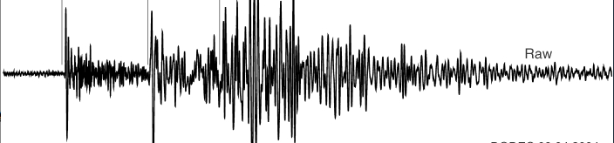
Bayesian Treaty Monitoring
PI: Stuart Russell, UC Berkeley
Award Number: HDTRA1-11-1-0026
Objective: Improved interpretation of seismic signals on a global scale, in particular increased sensitivity and accuracy of nuclear explosion monitoring.
events
traditional monitoring
inference
model
model
inference
NET-VISA
Method: Bayesian inference in a generative probability model of seismic events and global network signals.
detections
station
processing
SIG-VISA
waveforms
Status of effort: major components implemented and integrated, promising initial end-to-end results, continuing to scale computation towards global monitoring.
Personnel Supported: 1 faculty, 4 senior scientists (3 at LLNL led by Stephen C. Myers), 1 PhD student.
Publications & Meetings: Peer-reviewed paper at NIPS ’15 on large-scale GPs, poster presentation at AGU ‘15.
Results this year:
Formalizations of cross-correlation as a Bayesian statistic.
Event birth proposals using waveform correlations.
Operational results surpassing detection-based systems in monitoring the Western US.
Funding: FY12-17 $269k/$255/$267/NCE/$212/$219k
PI contact Information: Stuart Russell, russell@cs.berkeley.edu, (510) 642-4964

Slide 3
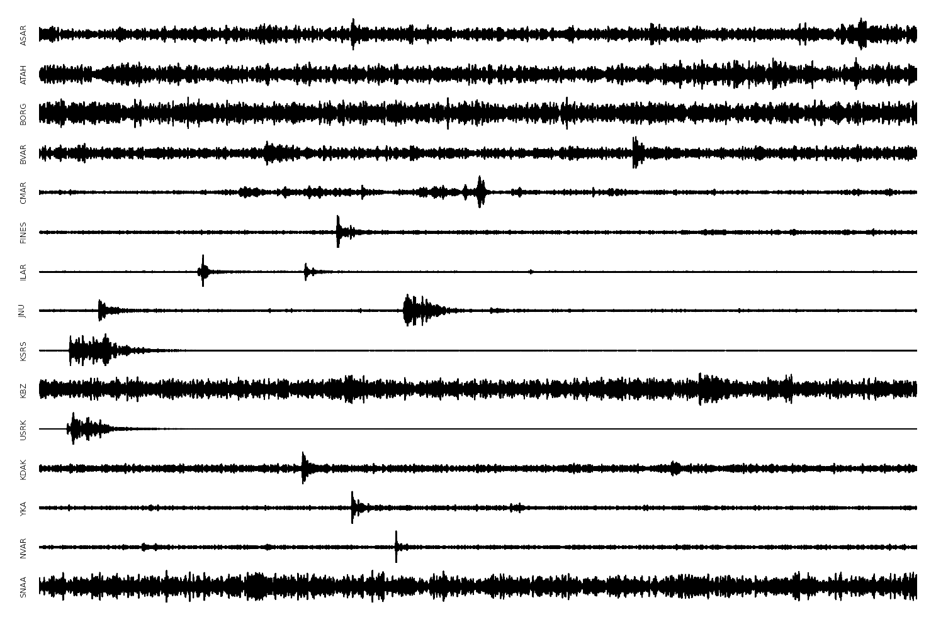
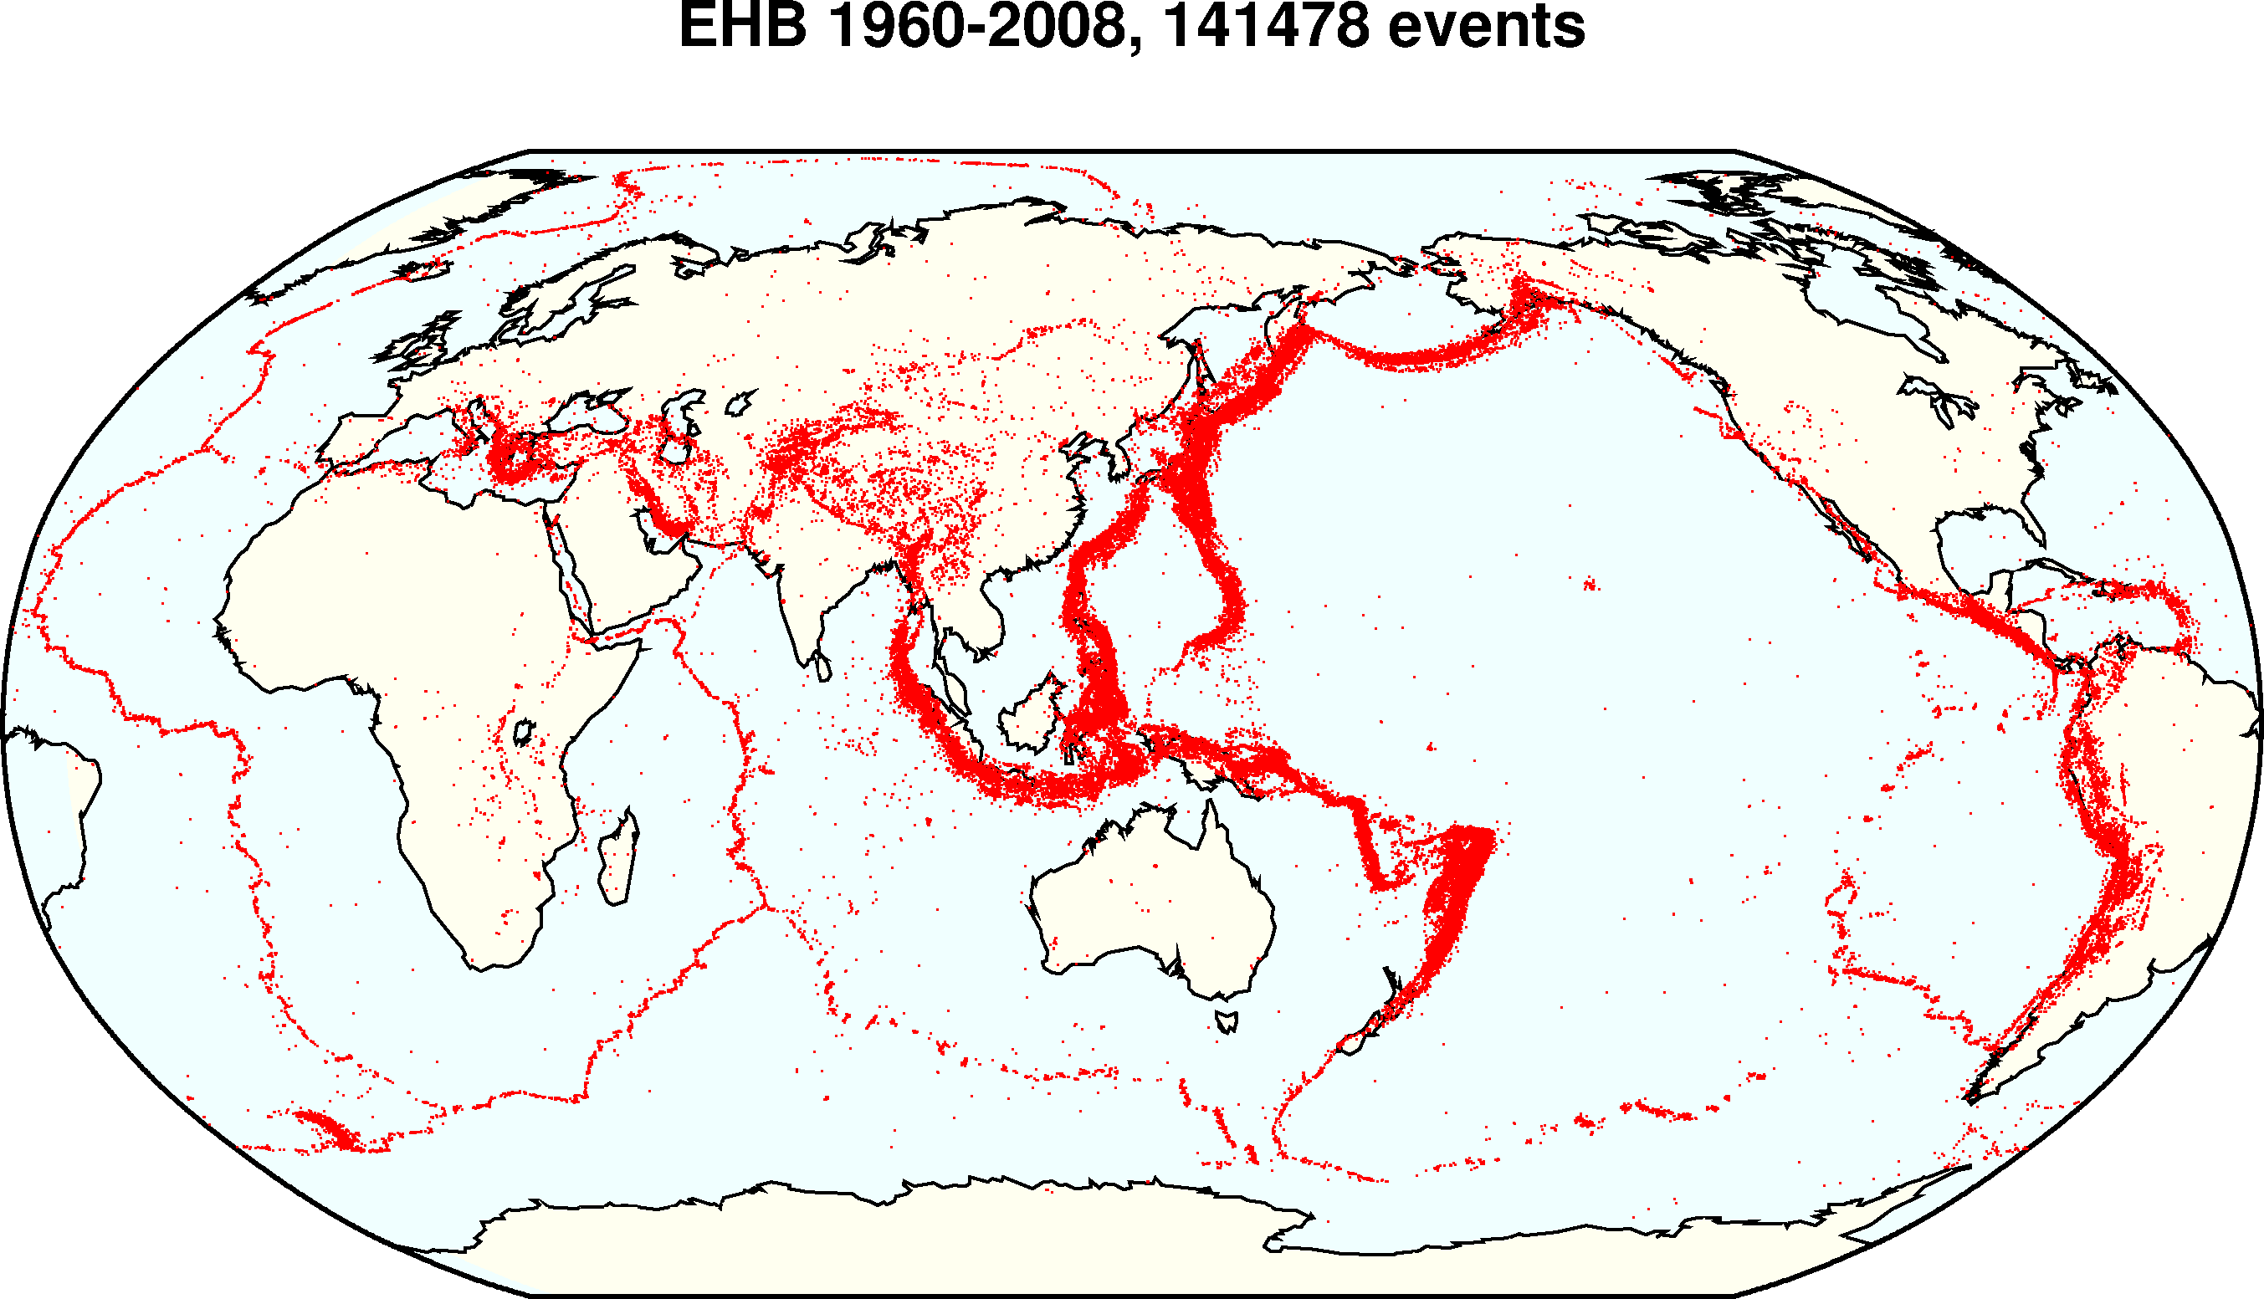
Program Objective
Problem: nuclear test monitoring.
Given seismic data, infer an event bulletin.
Approach: formulate as Bayesian inference on seismic signals.
Goal: improve monitoring sensitivity and accuracy.
Notes:
The objective of our work is to develop a new end-to-end approach to seismic monitoring. At a very high level, the monitoring problem is to take a bunch of incoming signals and infer a series of events that could have generated them. So this is one very big inverse problem, and we’re going to approach it with Bayesian statistical inference, with the goal of building a monitoring system that is more sensitive and more accurate than existing approaches.

Slide 4
Bayesian monitoring
P (events) describes prior over event histories.
P(signals | events) describes forward model based on knowledge of seismology and seismometry.
P(events | signals) ∝ P(signals | events) P(events)
(compute using MCMC, etc.)
Advantages:
Correct incorporation of all evidence
Interpretable and improvable by seismologists
Better models => better results
Notes:
I'll begin by sketching out how to view monitoring as problem in Bayesian statistics. If you're familiar with Bayesian statistics, you know we always start with a prior distribution on the thing we want to infer, in this case our prior is on event histories. The next piece is a forward model, where we have to specify, if we have some hypothesis for an event bulletin, what's a probability distribution for the signals those events could generate? This can include everything we know about the physics, how seismic waves are propagated through the earth and captured at each station.
Once we have these two components, a prior and a forward model, probability theory says that we can combine them via Bayes' rule to answer the question of, for the particular signals I *did* observe, what is a probability distribution or what is the most probable set of events to have generated those signals? This is called the posterior distribution, often finding it requires a lot of computation using algorithms such as MCMC.
Why is this Bayesian framework a good way to think about monitoring? One reason is that following the math of probability theory means it automatically handles uncertainty correctly, for example it automatically accounts for negative evidence from missing detections. Another is that it decouples the model from the inference algorithm: so we have a forward model that states very explicitly what your assumptions are, in a way that seismologists can interpret and contribute improvements to the model. And a more accurate model directly gives you better results, without having to tweak any specific algorithms. So we think this is an attractive property for a framework.

Slide 5
Detection-based and signal-based monitoring
waveform signals
Notes:
Now when we actually build a monitoring system, we have to choose how much of the data and the physics to include in our model. In monitoring we always start with the waveforms themselves, and

Slide 6
Detection-based and signal-based monitoring
detections
station
processing
waveform signals
Notes:
traditionally there is some station processing that looks at the waveform and tries to pick out a set of detections.

Slide 7
Detection-based and signal-based monitoring
events
Traditional monitoring
(GA/SEL3)
detections
station
processing
waveform signals
Notes:
Then in a system like GA, you keep moving up: you take these detections and try to construct a set of events.

Slide 8
Detection-based and signal-based monitoring
events
Traditional monitoring
(GA/SEL3)
model
inference
NET-VISA
detections
station
processing
waveform signals
NET-VISA = detection-based
Notes:
Now one way to be Bayesian is to build a forward model that starts with an event hypothesis and just tries to predict the detections that those events would generate. Then when you do inference you go backwards from the detections up to recover the events.

Slide 9
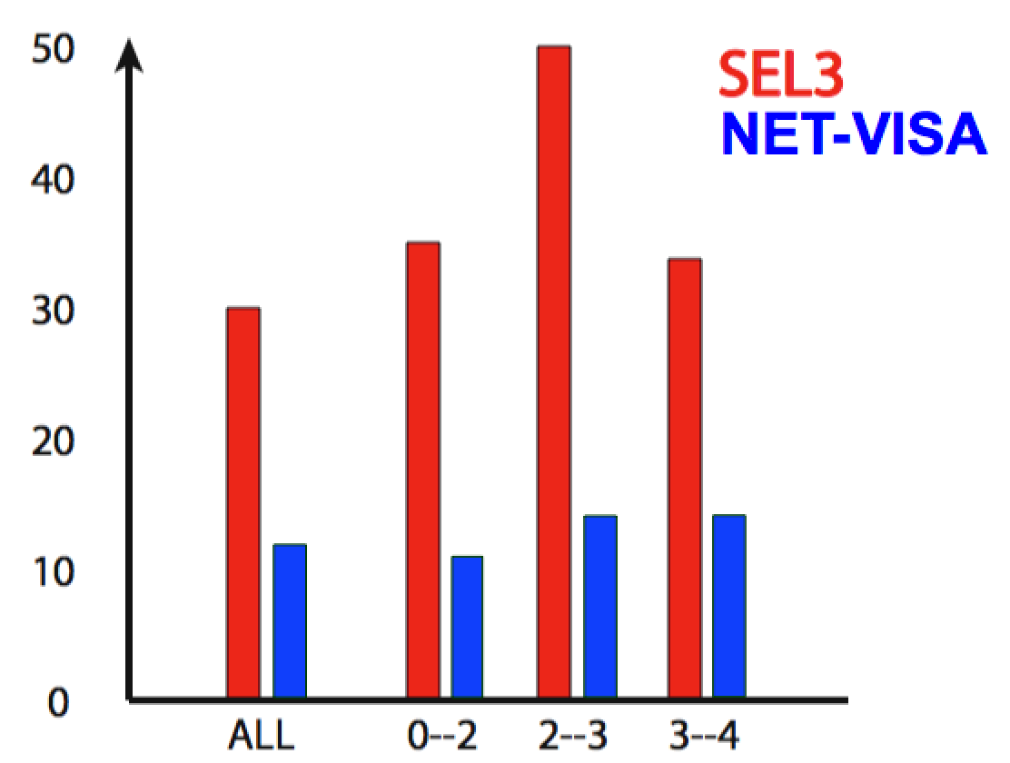
Detection-Based Bayesian Monitoring (NET-VISA, Arora et al.)
IMS global evaluation: ~60% reduction in missed events vs. GA/SEL3.
Identifies additional events missed by human analysts (LEB).
Currently being evaluated for deployment at the IDC.
Can we do better?
Missed events
Magnitude range (mb)
Notes:
This is the design choice that NET-VISA makes, it's detection-based Bayesian monitoring, which Nimar Arora has worked on. And it turns out that even being Bayesian in this limited setting still works really well: it misses 60% fewer events than the SEL3 bulletin which was the previous state of the art, across a range of magnitudes, and it even picks up some events which the human analysts miss but which we can corroborate by looking at regional catalogs. And that's currently being evaluated for production deployment at the IDC.
So we think this is a great proof of concept for the Bayesian approach, and it's natural to ask, what's next? How can we do better?

Slide 10
Detection-based and signal-based monitoring
events
Traditional monitoring
(GA/SEL3)
model
inference
NET-VISA
detections
station
processing
waveform signals
NET-VISA = detection-based
Notes:
The natural way to do better is to build a model that uses more of the available data, and includes a richer idea of the physics of the situation.

Slide 11
Detection-based and signal-based monitoring
events
Traditional monitoring
(GA/SEL3)
model
inference
inference
model
NET-VISA
detections
station
processing
SIG-VISA
waveform signals
NET-VISA = detection-based, SIG-VISA = signal-based
Notes:
The way we've done that is to use a forward model that goes from event hypothesis directly down to predict the signals themselves, so when we do inference we start from the raw signals and go backwards trying to infer events directly, without any station processing. We call this system SIG-VISA.

Slide 12
Signal-based monitoring
What aspects of the physics can we model?
Travel-time and attenuation models
-> instead of picking, soft template matching /
global beamforming
Spatial continuity of waveforms
-> waveform matching
-> sub-threshold detections
Spatial continuity of travel-time residuals
-> double differencing
Notes:
What aspects of the physics is it helpful to model? Of course we want to include the same sorts of things that a detection-based system would include, like a travel-time model and attentuation models, that make some assumptions about when phases should arrive and how much energy they'll carry. When we do Bayesian inference to invert these models, we'll turn out to get something that replaces traditional picking with a sort of soft template matching, and see that this even lets treat the whole global network as something analagous to a single big array that you can do beamforming on.
But another thing we can model is that waveforms themselves are spatially continuous, at least locally, so if you ahve two nearby events you'll expect them to generate similar waveforms at the same station. If you invert this assumption, you get waveform matching methods, and the potential to use waveform correlation for sub-threshold detections.
Finally we could also model continuity of travel-time residuals: if you have two nearby events the travel-time model is likely to make the same errors on both of them, so you can get their relative locations much more accurately than their absolute locations. If you invert this assumption you get methods like double-differencing.
What we'd like to do is include all of these assumptions about the physics in a single model, so when we do inference all of these effects fall out naturally.

Slide 13
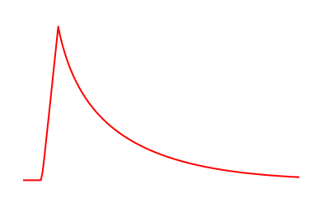
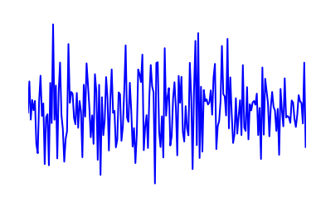
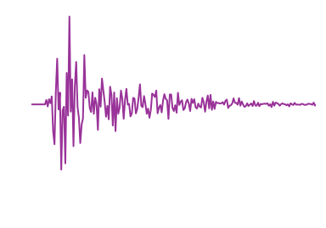
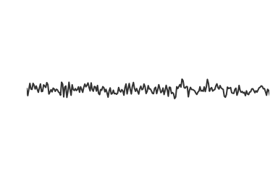
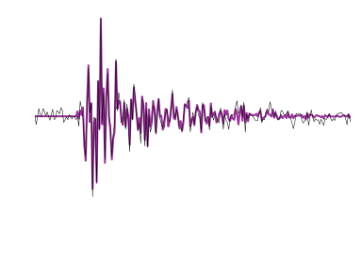
Forward model: single event/phase
Envelope template: parametric shape depends on event magnitude, depth, location, phase.
×
Repeatable modulation: the “wiggles”, depends on event location, depth, phase.
+
Background noise: autoregressive process at each station.
=
Observed signal: sum of all arriving phases, plus background noise.
Notes:
Start from the bottom
build?
pictures comfusing: no purple at bottom?

Slide 14
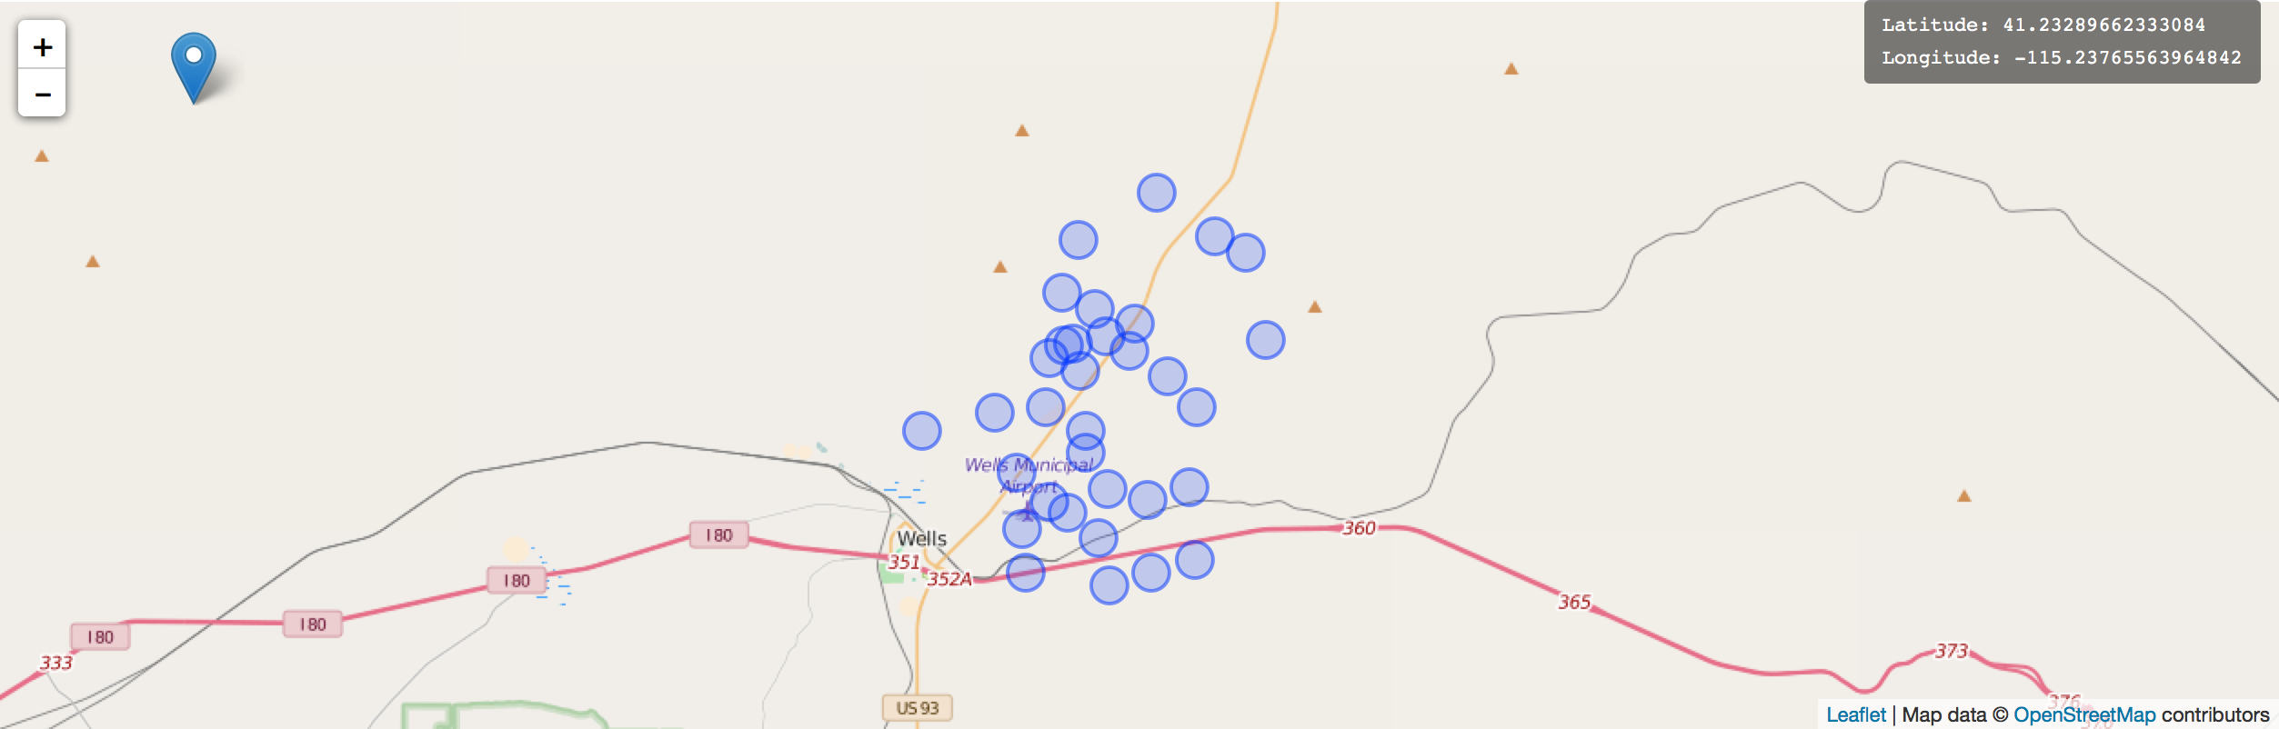
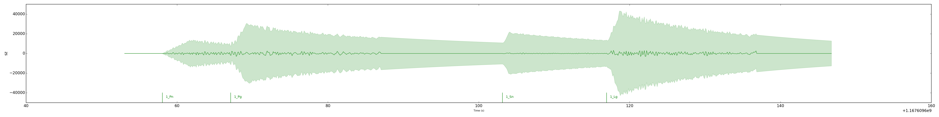
Forward model: Demo

Slide 15
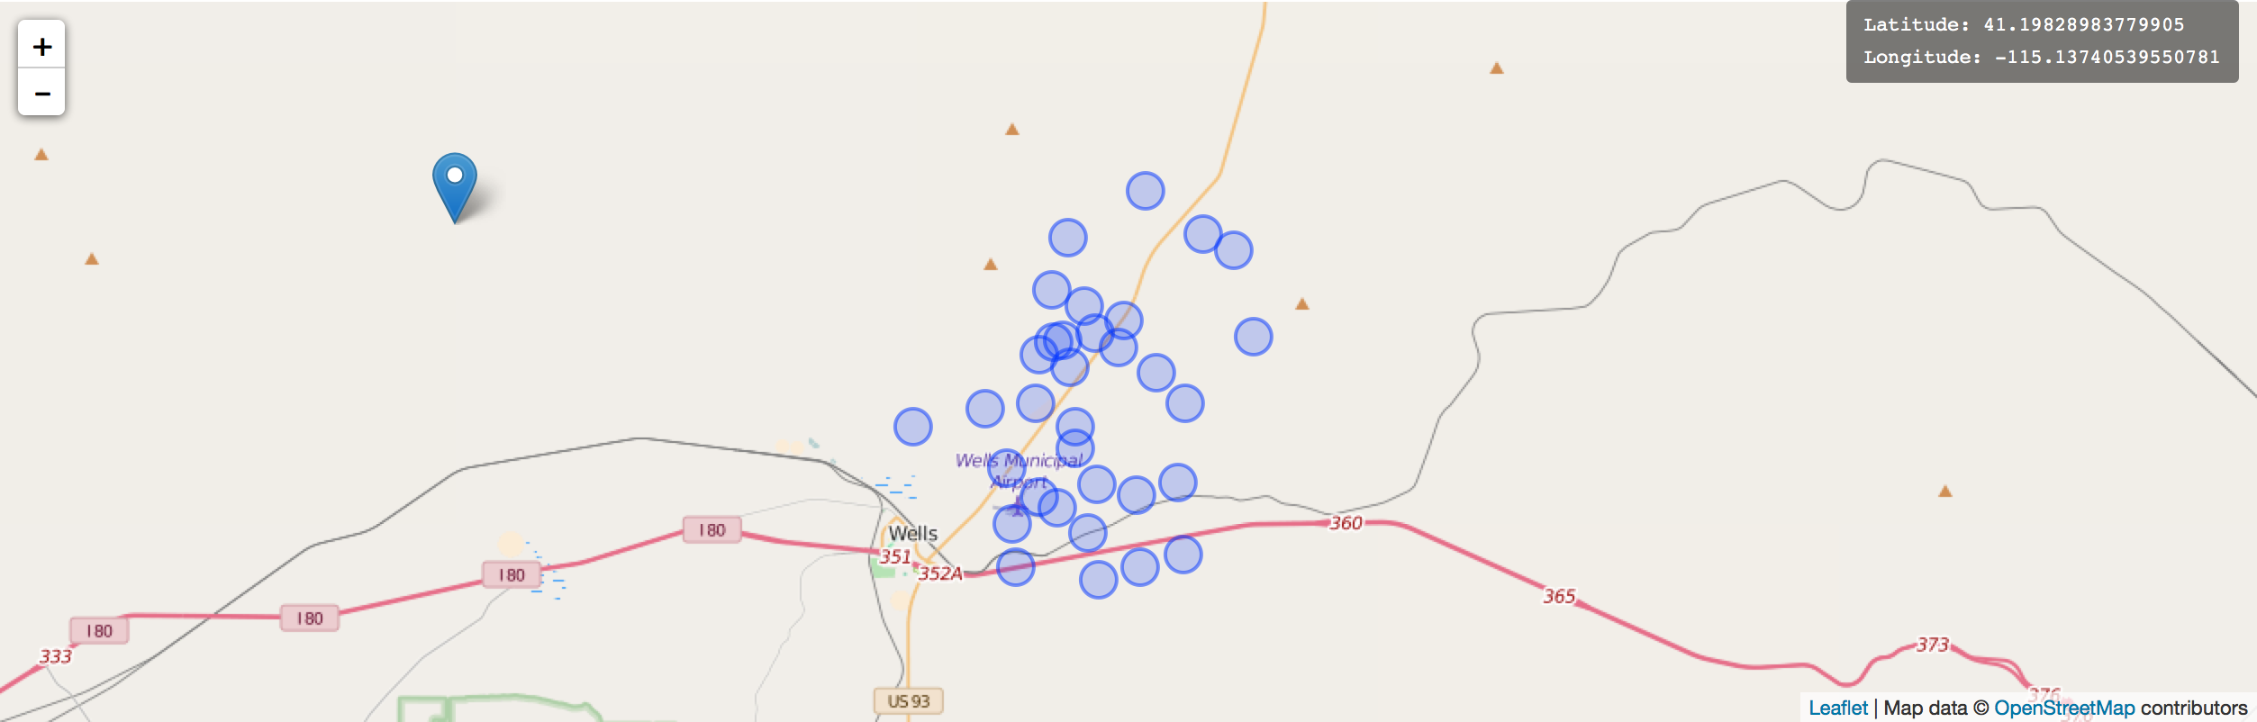
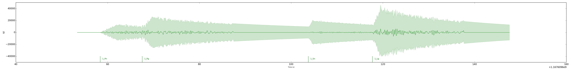
Forward model: Demo

Slide 16
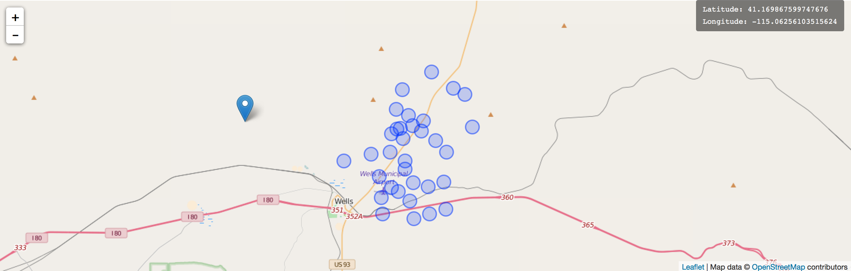
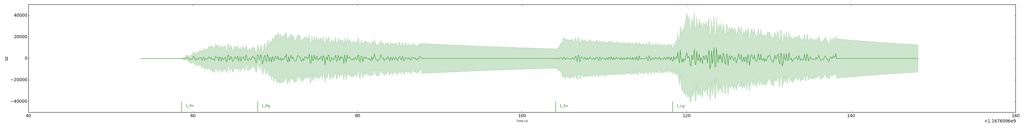
Forward model: Demo

Slide 17
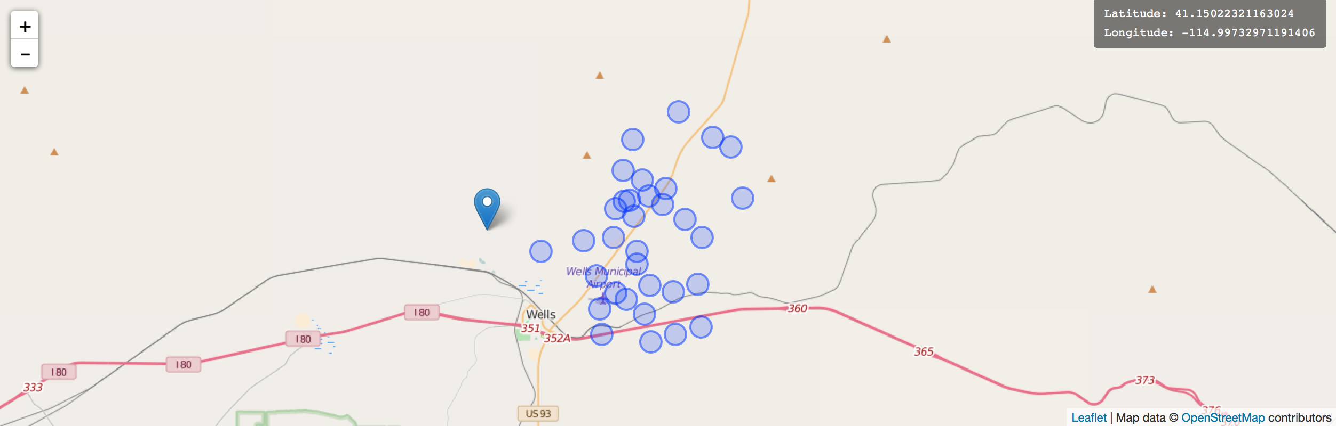
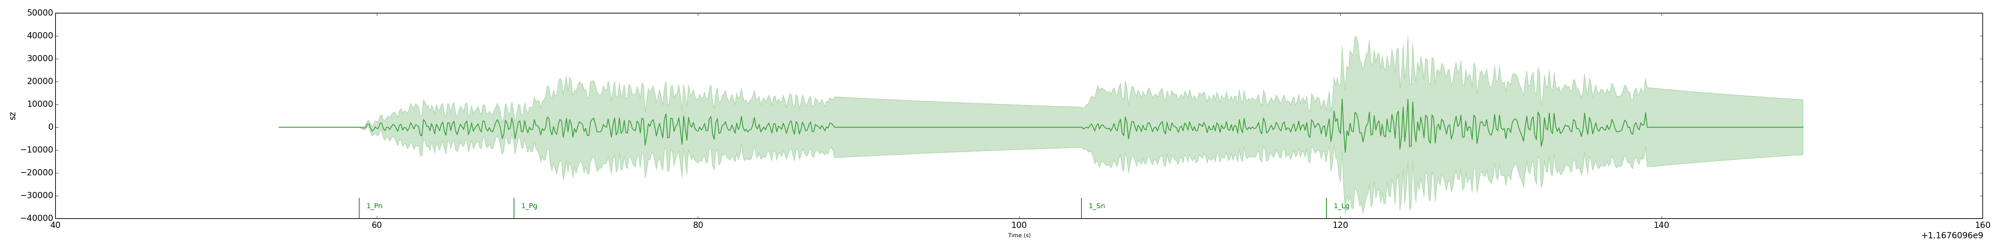
Forward model: Demo

Slide 18
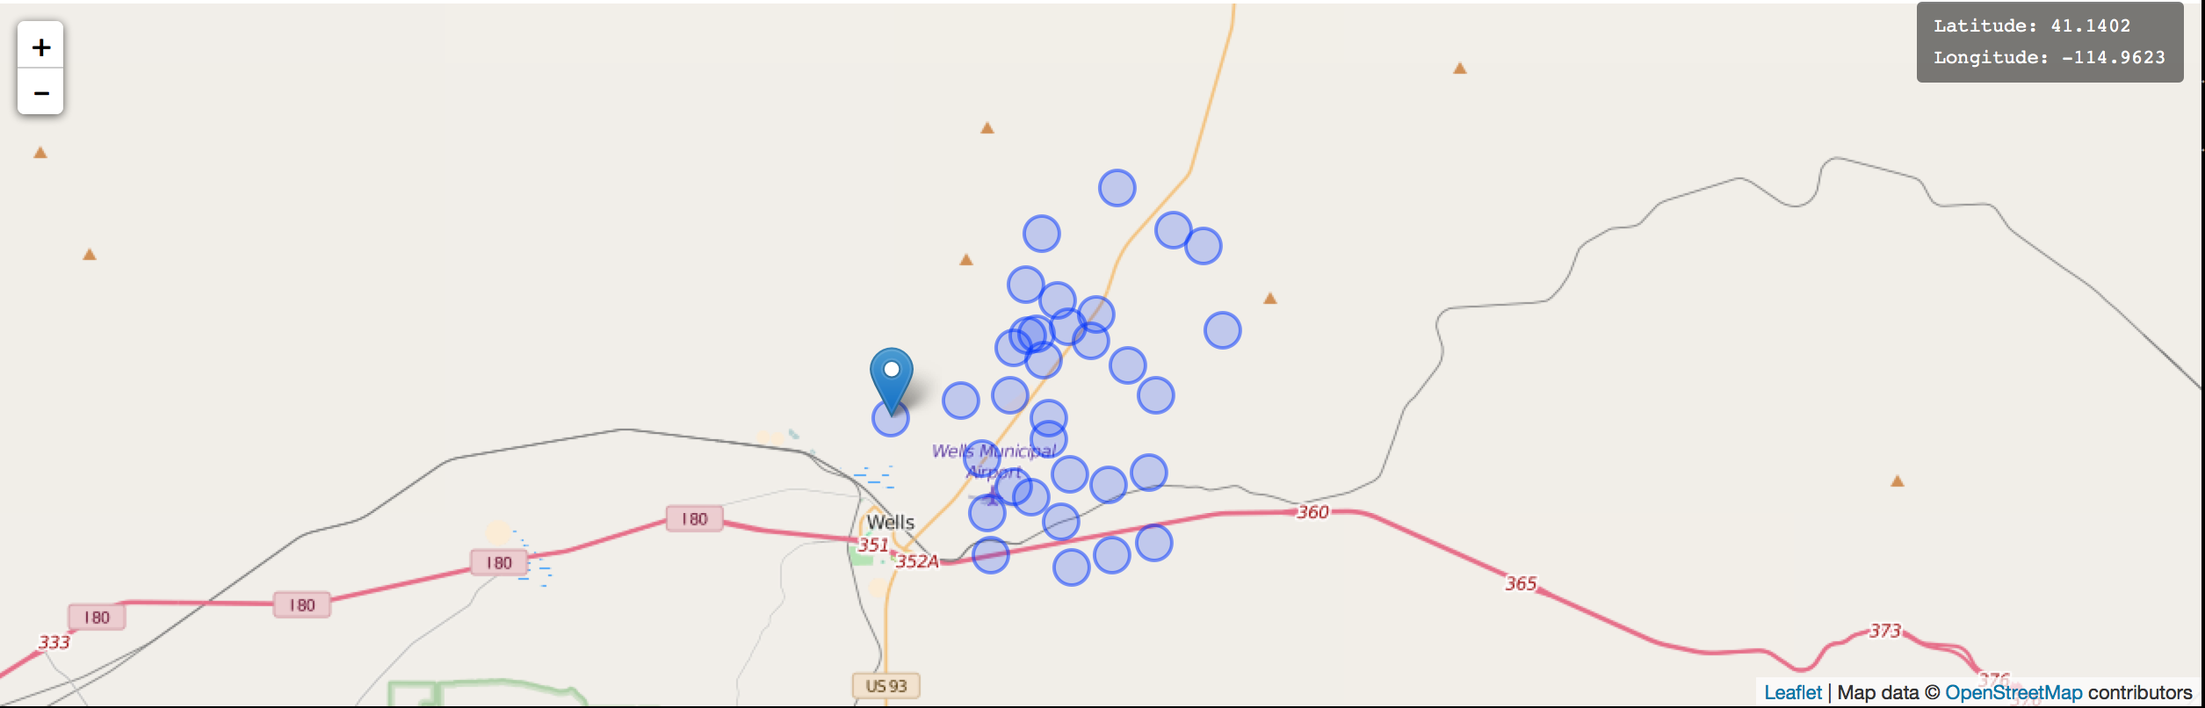
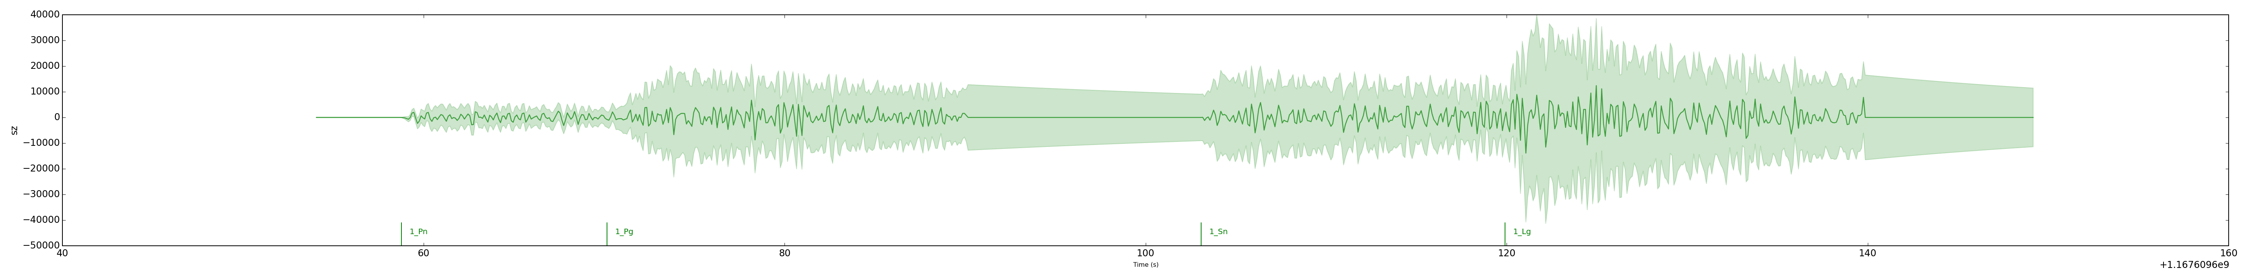
Forward model: Demo

Slide 19
Inference
Given observed signals, sample from model posterior P(events | signals).
Run Metropolis-Hastings algorithm (MCMC) over
# events, # phases (reversible jump, birth/death moves)
Event location, depth, magnitude, time
Envelope shape parameters
Noise process parameters
Success requires well-chosen proposal moves.
Notes:
\alpha(x'|x) = \min\left\{1, \frac{\textcolor{red}{
\pi(x')}q(x|x')}{\textcolor{red}{\pi(x)}q(x'|x)}\right\}

Slide 20
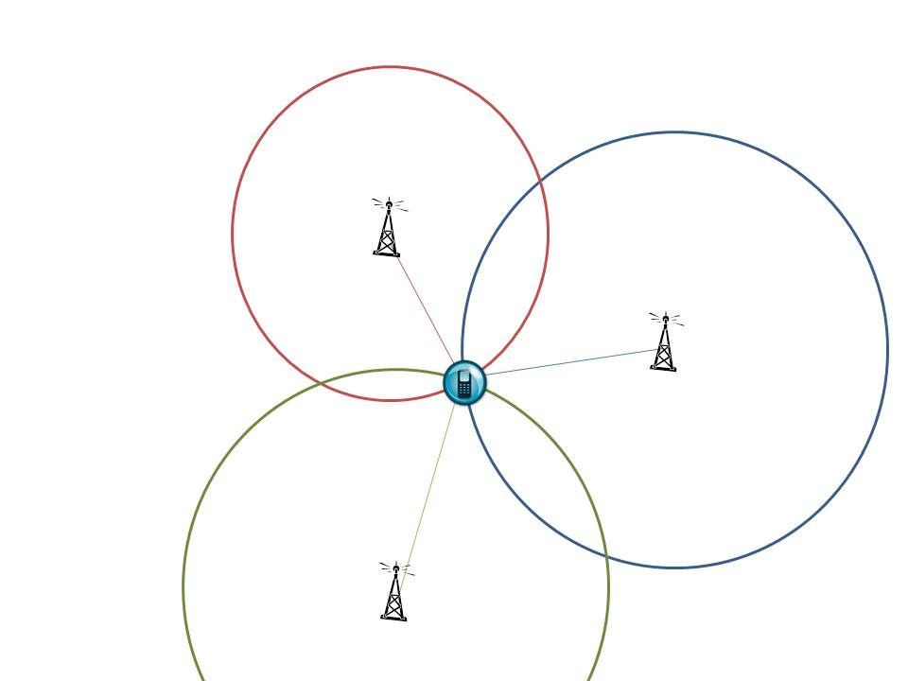
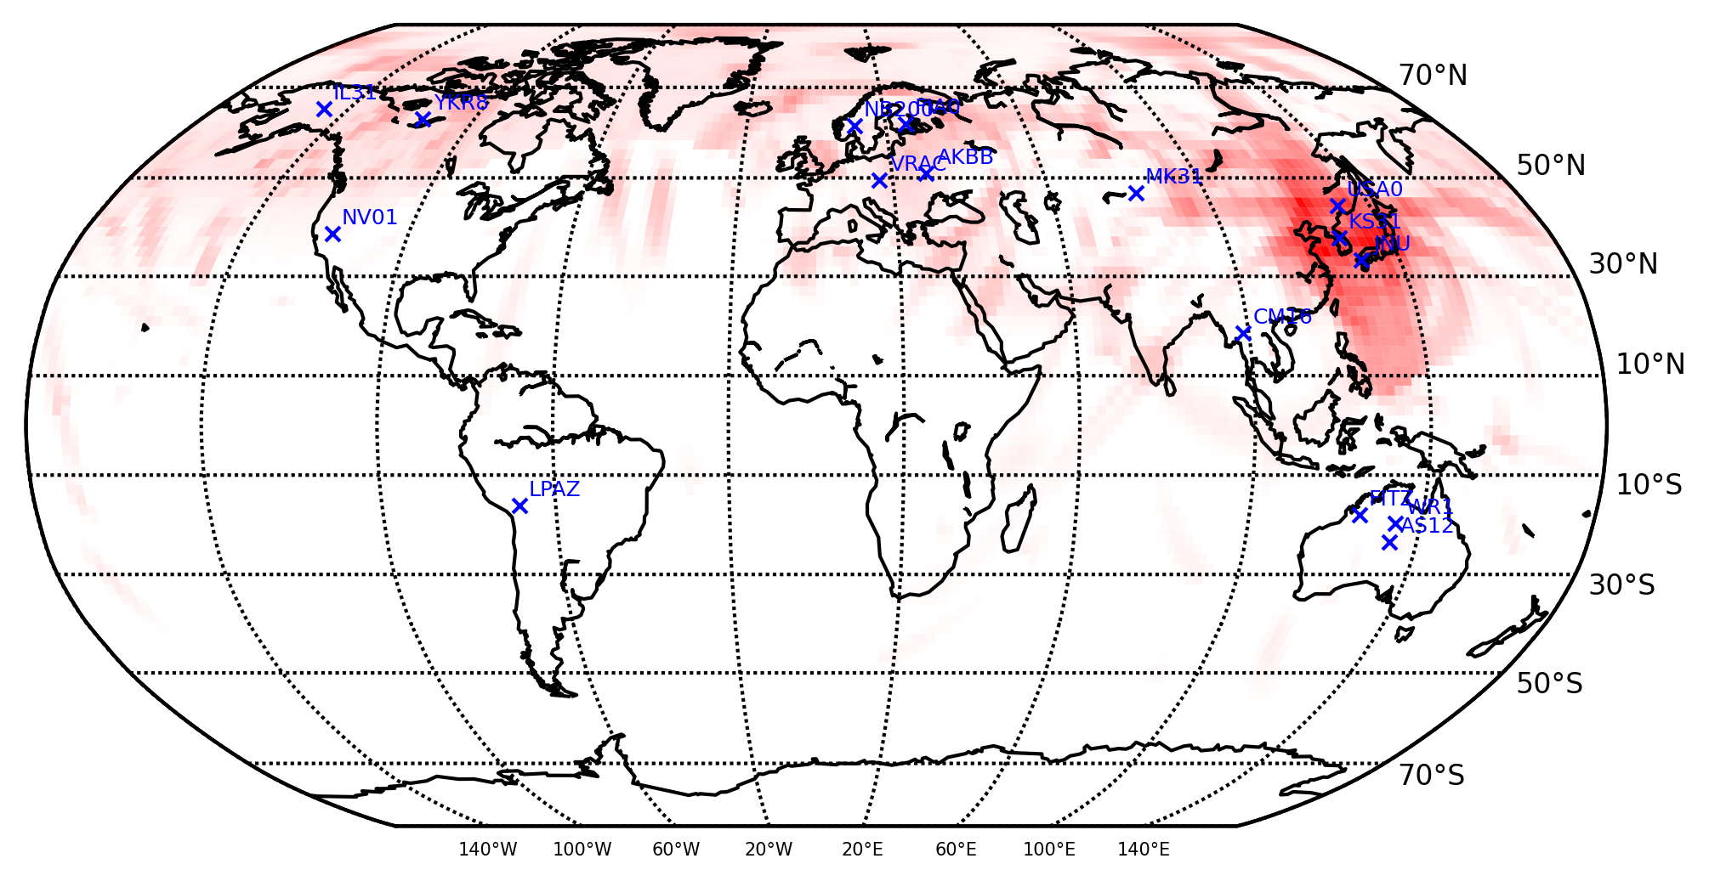
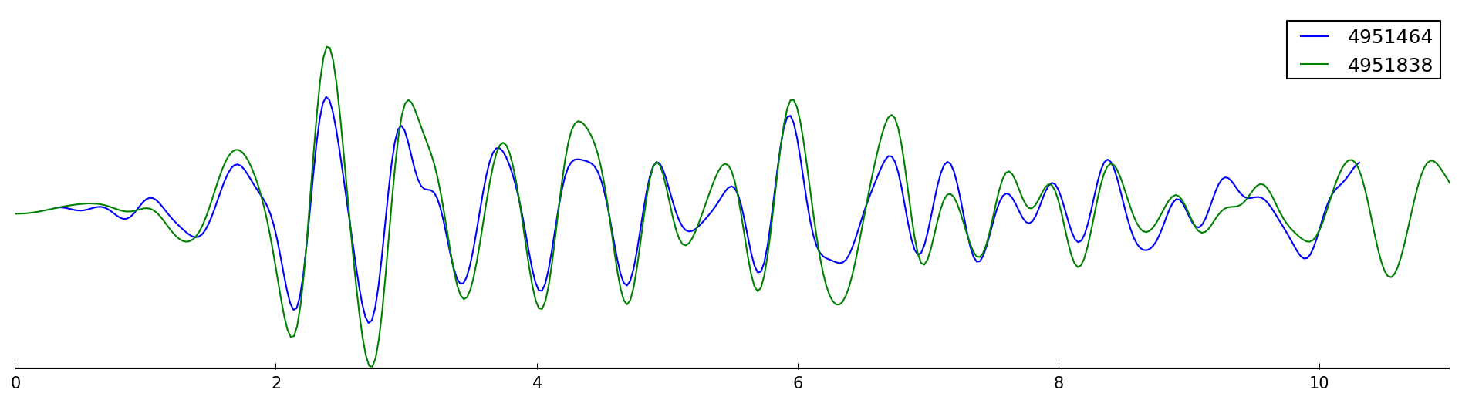
Inference: event birth proposals
Complimentary heuristics:
Multilateration from travel-time alignments
-> Hough transform proposals
for de novo events
Signal correlations with historical data
-> Waveform matching
proposals

Slide 21
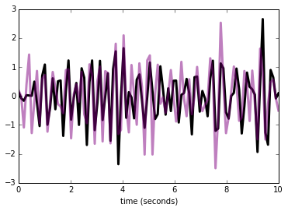
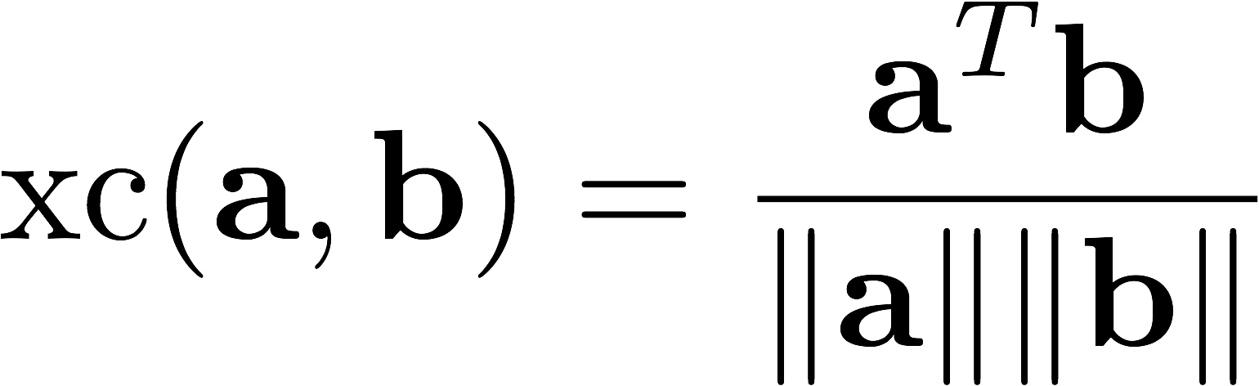
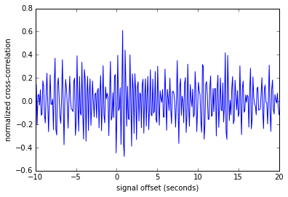
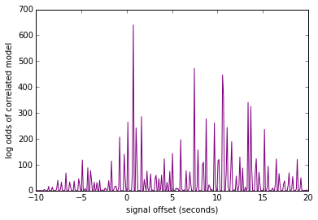
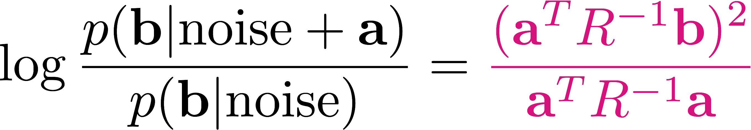
Waveform correlation proposals
Normalized cross-correlation is almost a log probability.
Simple probability model gives a closed-form, correlation-like posterior over signal alignments.

Slide 22
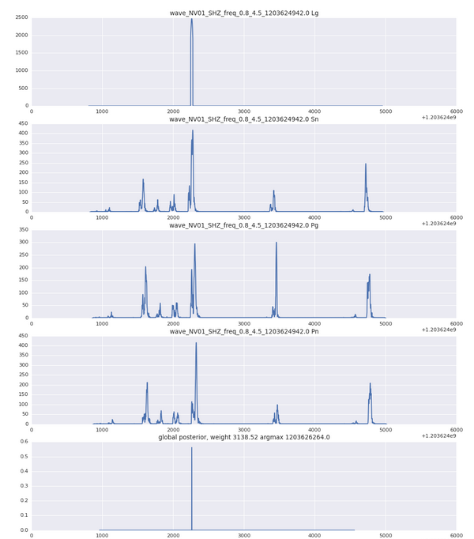
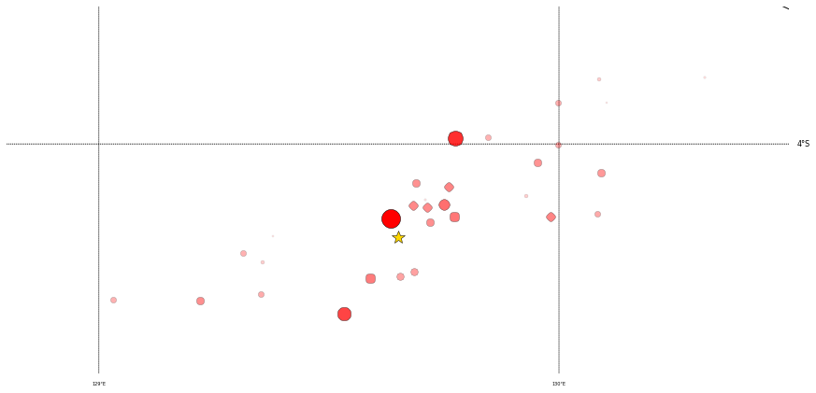
Waveform correlation proposals
Combining evidence from multiple phases/stations gives
posterior on event time
marginal likelihood of training event
Location proposal: mixture of Gaussians at training events, weighted by marginal likelihood.

Slide 23
Monitoring the Western US
Two-week period following Feb 2008 event at Wells, NV (6.0).
Reference bulletin: ISC regional catalog, with Wells aftershocks from US Array.
Compare IMS-based bulletins:
Global Association / SEL3
LEB (human analysts)
NETVISA (detection-based Bayesian)
SIGVISA (this work, signal-based Bayesian)

Slide 24
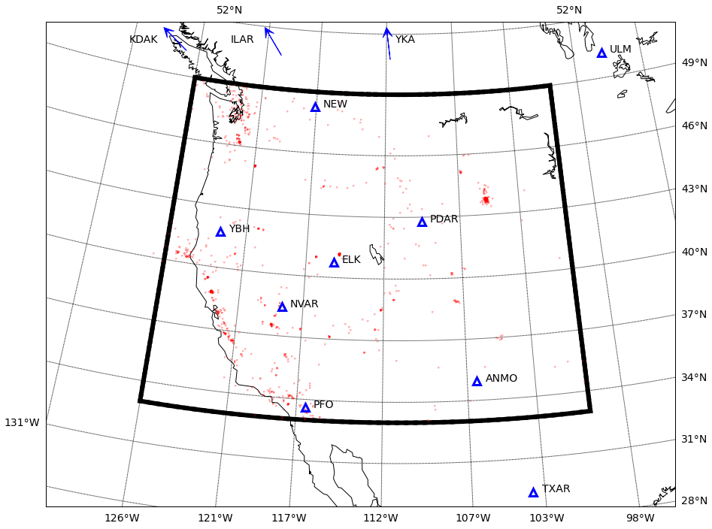
Historical data (one year, 1025 events)

Slide 25
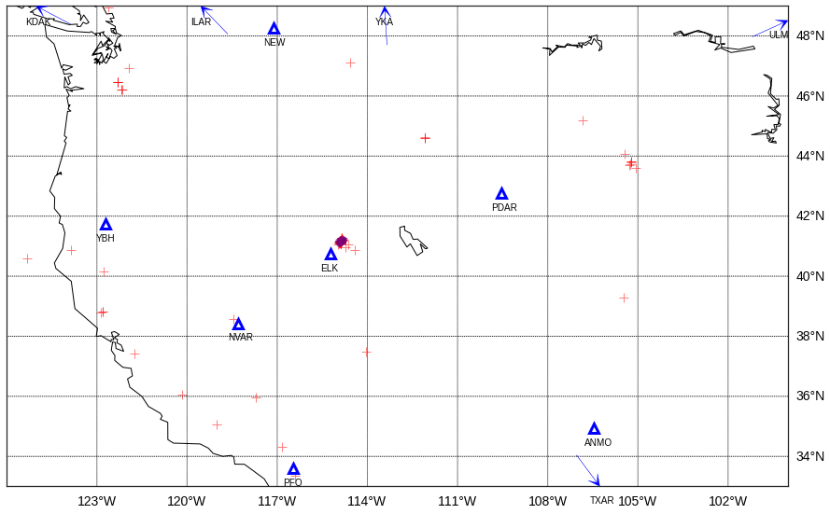
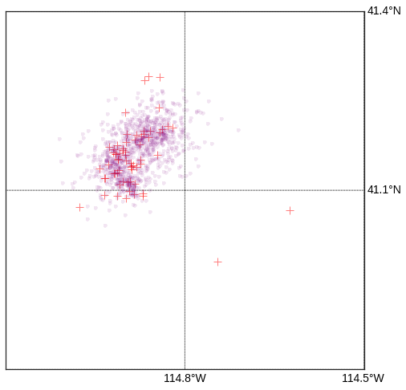
Reference bulletin (two weeks, 1046 events)
Wells region

Slide 26
Evaluation
Match events to ISC reference bulletin (≤ 50s, ≤ 2° discrepancy)
Precision: of inferred events, % in reference bulletin.
Recall: of reference events, % that were inferred.
Location error: distance (km) from inferred to reference locations.

Slide 27
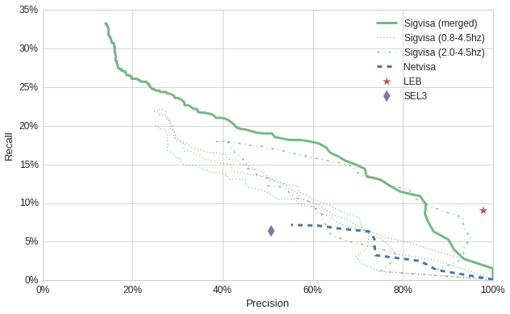
Precision / Recall
Sigvisa (all)
Sigvisa (top)

Slide 28
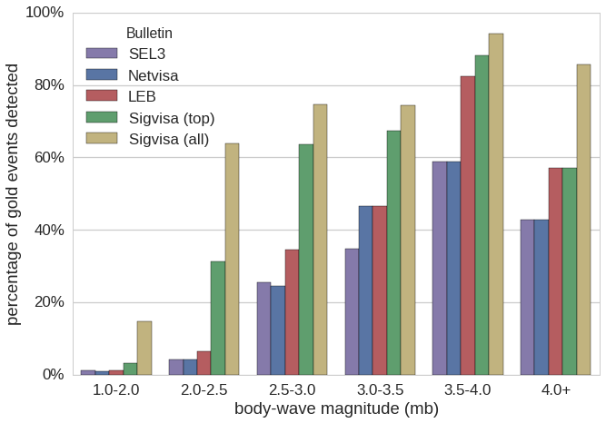
Recall by magnitude range

Slide 29
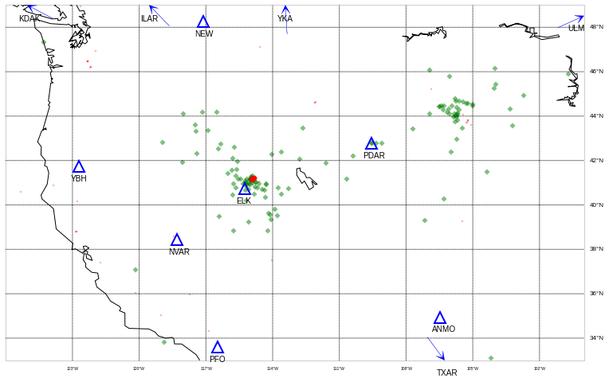
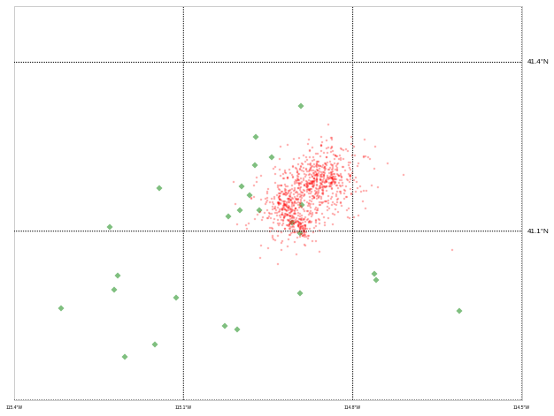
GA / SEL3 (132 events)
Wells region

Slide 30
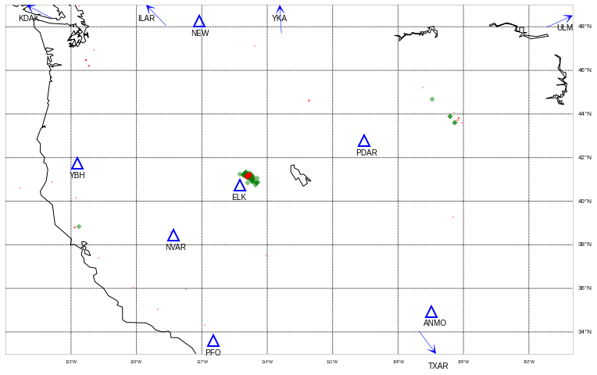
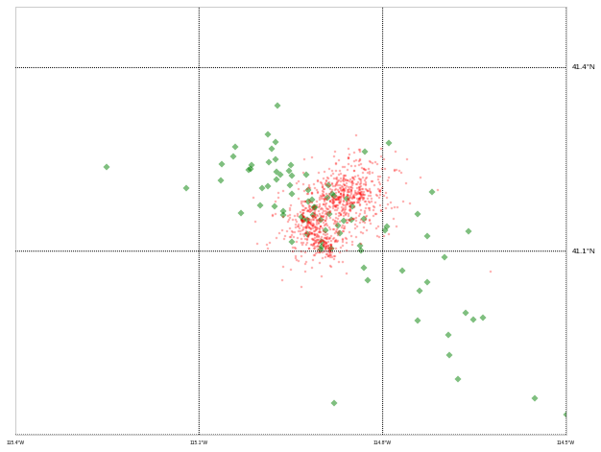
LEB (96 events)
Wells region

Slide 31
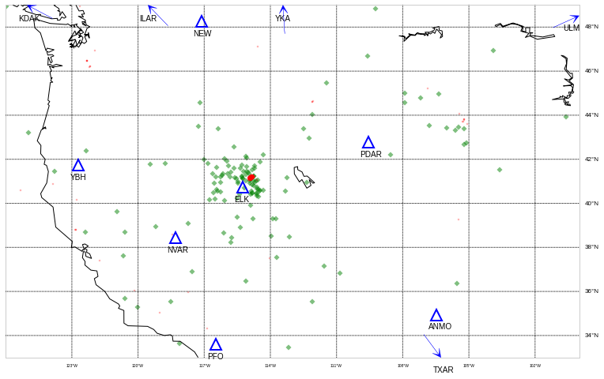
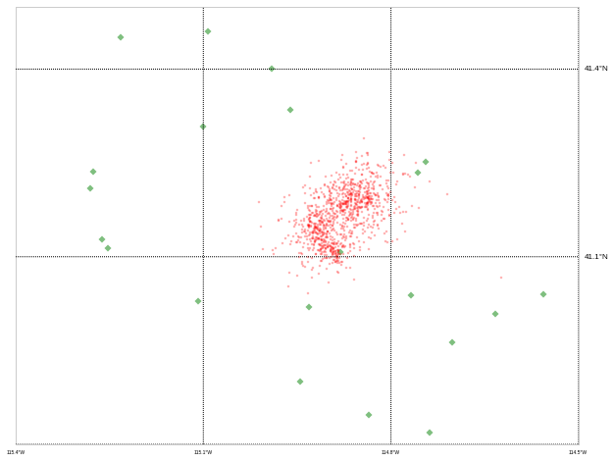
NETVISA (139 events)
Wells region

Slide 32
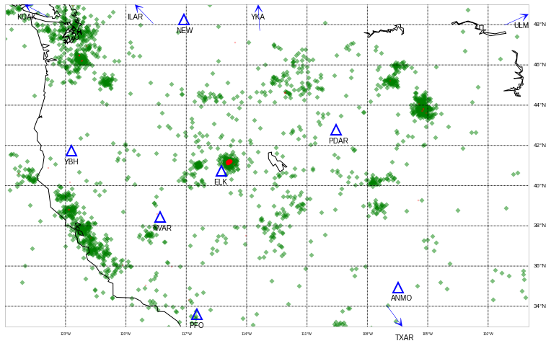
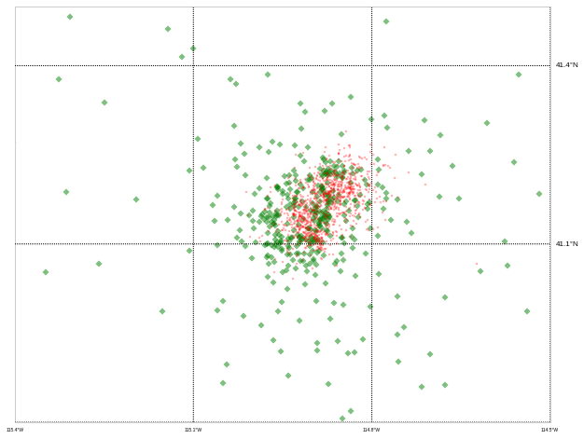
SIGVISA (all 2491 events)
Wells region

Slide 33
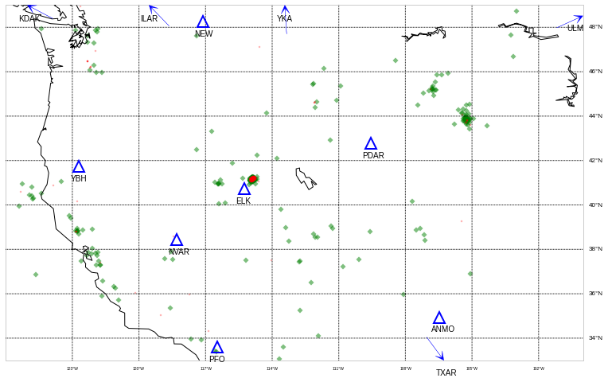
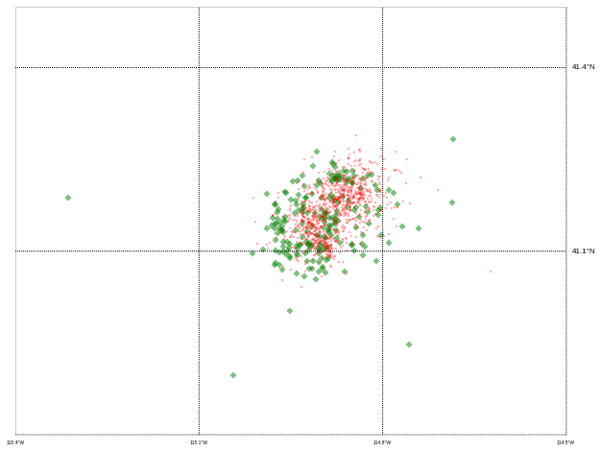
SIGVISA top events (393)
Wells region

Slide 34
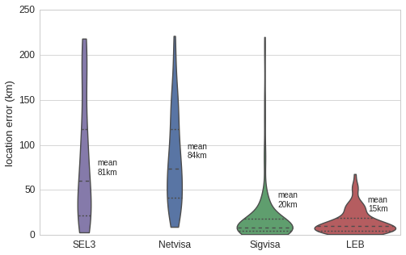
Distribution of location errors (km)

Slide 35
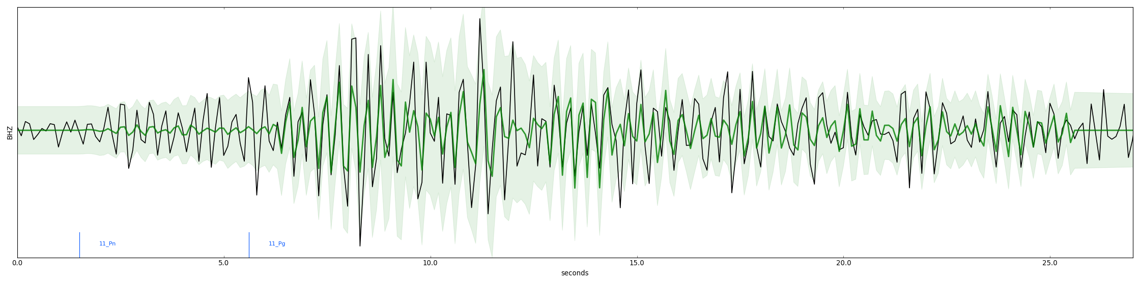
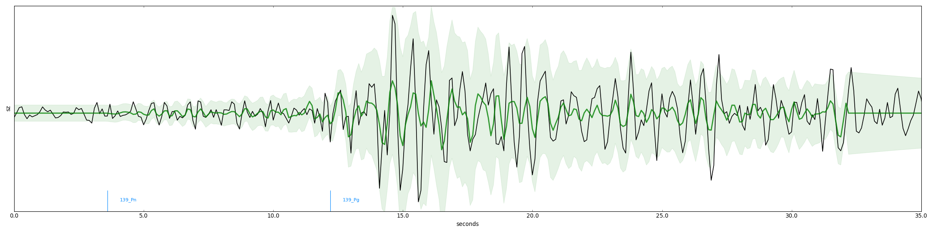
Better than reference bulletin?
Likely mining explosion at Black Thunder Mine (105.21° W, 43.75° N, mb 2.6, PDAR)
Event near Cloverdale, CA (122.79° W, 38.80° N, mb 2.6, NVAR)

Slide 36
De novo events
Monitoring requires detection capability even with no known prior seismicity.
Define de novo as ≥ 50km from recorded historical event.
ISC bulletin contains 24 such events between January and March 2008.

Slide 37
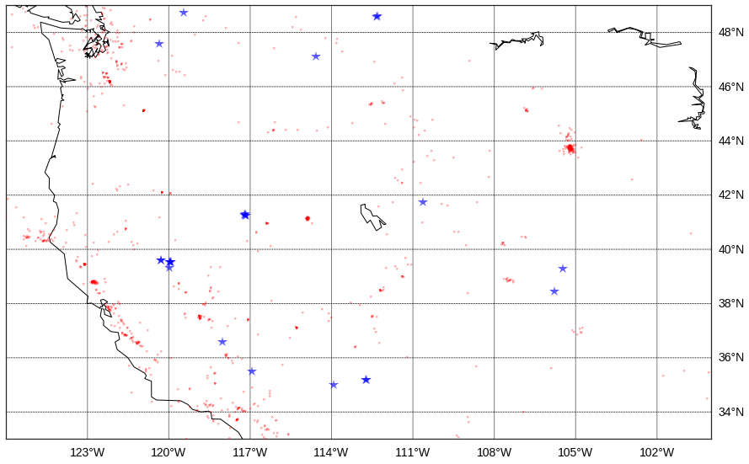
De novo reference events
(24 in 3 months)

Slide 38
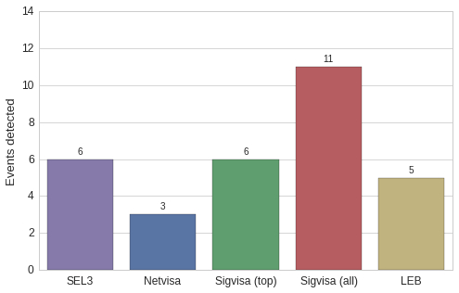
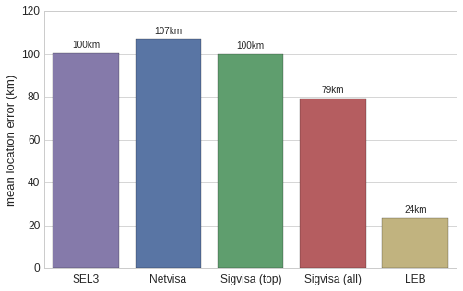
De novo evaluation
Recall (% detected)
Mean location error

Slide 39



De novo missed by SEL3/LEB
^{NVAR (distance 183km)}
^{YBH (distance 342km)}
ELK (distance 407km) NO DETECTIONS REGISTERED
Notes:
Event at 119.79◦W, 39.60◦N

Slide 40
Next Steps
Support array stations and 3C polarization analysis.
Expand source models to include orientation, duration, spectral content.
Train from LEB catalog (requires joint relocation of training events).
Scale training and inference procedures to full global network monitoring (from ~12 to ~150 stations ).

Slide 41
Accomplishments
Publications:
Moore, David A. and Russell, Stuart. “Gaussian Process Random Fields”, Neural Information Processing Systems (NIPS 2015).
Presentations:
Neural Information Processing Systems (NIPS), Montreal, Canada. (December 2015)
American Geophysical Union Fall Meeting (AGU), San Francisco, CA. (December 2015)
Undergraduate research projects:
Zhiyuan Lin: GPU parallelization of Kalman filter likelihoods
Jun Song: Parallel sampling via Chromatic Metropolis-Hastings
PhD theses:
Moore, David A. Signal-Based Bayesian Seismic Monitoring, UC Berkeley. (expected Summer 2016)

Slide 42
Conclusions
SIG-VISA’s forward model captures physical assumptions of waveform matching, double differencing, array beamforming, and detection-based systems, in a unified Bayesian inference system.
New inference proposals using probabilistic formulation of cross-correlation.
Western US results: 3x recall vs SEL3 (2.6x vs NETVISA) at same precision, detects de novo events missed by detection-based systems.
Notes:
So in conclusion: modeling the actual signals gives you the precise locations that you'd get from waveform matching, along the sub-threshold detections from waveform correlations, the same kind of noise reduction as array beamforming but using the entire network, the precise relative locations you'd get from double differencing, while still including absolute travel times so you get locations for de novo events. And we do all of this in a unified Bayesian inference system that trades off all of these phenomena consistent with their uncertainties. So, we think this is a very promising approach to monitoring, the initial results are promising. And right now we're working to scale the system up to run on larger datasets so I think at the next SnT we'll be able to come back and show that this really is the next generation of monitoring after NET-VISA. Thanks.

Slide 43


Global Beamforming
AKTO, 0.8-4.5Hz, 60s
Notes:
Okay, I want to give a few examples of the sorts of extra information this model lets us get out of seismic signals. The first thing I want to illustrate is just using the template model and how lets you replace picking with what I'd call global beamforming, treating the whole network as a giant array. To illustrate that I have an event here and a just a few stations, and I generated some synthetic data to have very weak signals, I started by sampling background noise,

Slide 44

Global Beamforming
AKTO, 0.8-4.5Hz, 60s
Notes:
then for each station I sampled a P arrival time,

Slide 45

Global Beamforming
AKTO, 0.8-4.5Hz, 60s
Notes:
and a shape for the template that gets added in

Slide 46

Global Beamforming
AKTO, 0.8-4.5Hz, 60s
Notes:
So the final signal that I get has some extra energy from the event, but not a lot.

Slide 47







Global Beamforming
AKTO, 0.8-4.5Hz, 60s
Notes:
If you look at these signals across stations, most of them you can see maybe a little bit of a bump but probably not enough to be confident of a detection.

Slide 48

Global Beamforming
Notes:
But there is some information there, and if you have a guess for the event location, you can try lining up the signals according to the travel times and see what you get. If your guess is wrong, they'll all cancel each other out and you get nothing.

Slide 49


Global Beamforming
Notes:
But there is some information there, and if you have a guess for the event location, you can try lining up the signals according to the travel times and see what you get. If your guess is wrong, they'll all cancel each other out and you get nothing.

Slide 50



Global Beamforming
Notes:
But if you guess right, everything lines up and you can start to see the signal appear out of the noise. Now I just showed a simple average for illustration but it’s not quite that simple because in real data you don't expect every detail of the signals to align, you'd expect that at different stations you'd have different shapes, different onset periods or coda decay rates, and our model accounts for that. So this is a phenomenon that gives you evidence for an event, and some information about its location, even from very weak signals where you would never have picked out any detections.

Slide 51

Open-universe: Template Births
Proposal: peak location ∝ (signal – current templates)²
Notes:
∝

Slide 52

Open-universe: Template Births
Proposal: peak location ∝ (signal – current templates)²

Slide 53

Open-universe: Template Births
Proposal: peak location ∝ (signal – current templates)²

Slide 54

Open-universe: Template Births
Proposal: peak location ∝ (signal – current templates)²

Slide 55

Open-universe: Template Births
Proposal: peak location ∝ (signal – current templates)²

Slide 56

Open-universe: Template Births
Proposal: peak location ∝ (signal – current templates)²

Slide 57

Open-universe: Template Births
Proposal: peak location ∝ (signal – current templates)²

Slide 58

Open-universe: Template Births
Proposal: peak location ∝ (signal – current templates)²

Slide 59

Open-universe: Template Births
Proposal: peak location ∝ (signal – current templates)²

Slide 60

Open-universe: Template Births
Proposal: peak location ∝ (signal – current templates)²

Slide 61

Open-universe: Template Births
Proposal: peak location ∝ (signal – current templates)²

